Slide 1



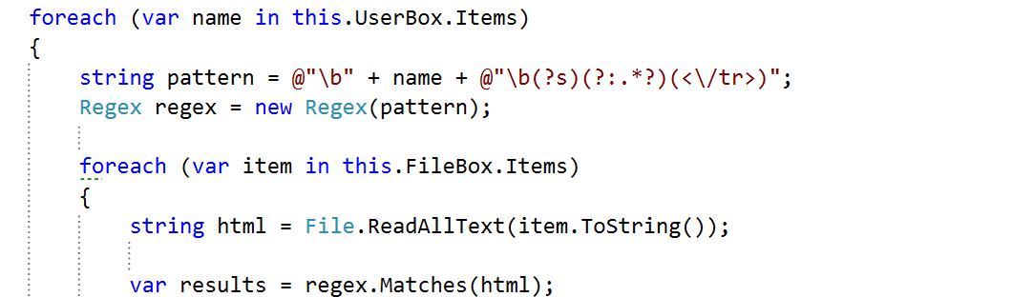
C# Advanced
Course Introduction
C#
SoftUni Team
Technical Trainers
Software University
http://softuni.bg

Slide 2
Questions
sli.do #8242

Slide 3









SoftUni Diamond Partners

Slide 4
C# Web Profession
C# Fundamentals Module
C# Advanced Course
Fully supported by Microsoft
~500 Offers @ Jobs.BG
Scope
Trainers
Evaluation

Slide 5
C# Web Profession
C# Fundamentals Module
C# Advanced Course
Algorithmic and Conceptual Courses
Prelude to Database and Web Technology Courses
Scope
Trainers
Evaluation

Slide 6
C# Web Profession
Standard .NET API
C# Fundamentals Module
Algorithmic thinking
C# Advanced Course
Scope
Trainers
Evaluation

Slide 7
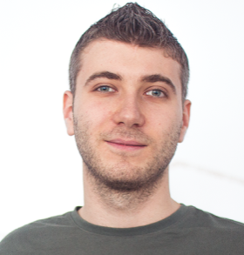
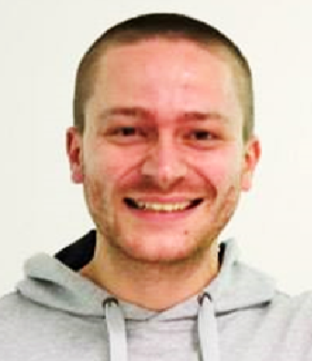


C# Advanced Course
Scope
Trainers
Evaluation

Slide 8
Trainers
Ivan Yonkov
Training Lead & Trainer @ SoftUni
5 years of programming experience mainly with Java and PHP
Solid experience as QA engineer
Top performing student from the Software University (2014)

Slide 9
Trainers
Ivaylo Kenov
Freelance Developer and Trainer
Mathematical competitions champion
Champion from Telerik Software Academy

Slide 10
Trainers
Bozhidar Gevechanov
Technical Trainer @ Software University
Top performing student from the Software University
Interests in Game Development, mainly in C#

Slide 11
Trainers
Svetlin Galov
Technical Trainer @ Software University
Top performing student from the Software University
Deep interest in Data Structures, Algorithms and Artificial Intelligence
Graduated from Business Academy of Aarhus (Denmark) with AP in Multimedia Design and Communications ( http://eaaa.dk )

Slide 12
Trainers
C# Advanced Course
Scope
Evaluation

Slide 13
Examination
Activities
Bonuses
Forum Activity
Nested Linear Structures
Attendance
Algorithmic Problem
C# Advanced Course
75%
25%
10%
Nested Data Structures
10%
String Processing
Scope
10%
5%
Trainers
Evaluation
Teamwork Project
Exercises
Labs

Slide 14
C# Web Profession
C# Fundamentals Module
C# Advanced Course
Scope
Trainers
Evaluation

Slide 15


Your RFID Chip
Students can either
Take RFID chip from SoftUni
Or use their own chip / card
Register your chip number in your SoftUni profile: https://softuni.bg/users/profile/show
Check-in at the reception every time when you come
See your last visits in your profile: https://softuni.bg/users/profile/show

Slide 16









Resources
What We Need Additionally?

Slide 17

Course Web Site & Forums
The C# Advanced official web page:
Register for the "Software University Forum":
Discuss the course exercises with your colleagues
Find solutions for all course exercises
Share source code / discuss ideas / help each other
https://softuni.bg/courses/advanced-csharp
http://softuni.bg/forum

Slide 18



The C# Advanced Slides and Videos
All lecture slides, videos, exercises, projects and other resources are open content, available for free
Visit the course web site to access the course resources

Slide 19

The Free C# Fundamentals Textbook
The official textbook for the course
"Fundamentals of Computer Programming with C#", by Svetlin Nakov & Co., 2013, ISBN 9789544007737
English and Bulgarian versions (as PDF, ePub, …)
Freely downloadable from: www.introprogramming.info
The C# Programming courses @ SoftUni.bg partially follows the book

Slide 20


Required Software
Software needed for this course:
Microsoft Windows (Win 10 / 8.1 / Win8 / Win7)
Visual Studio Community 2015 (a free version of VS 2015)
Visual Studio 2013, 2012, 2010 acceptable, but not recommended
.NET Framework 4.6 (included in Visual Studio)

Slide 21
C# Advanced– Course Intro
https://softuni.bg/courses/advanced-csharp

Slide 22
License
This course (slides, examples, demos, videos, homework, etc.) is licensed under the "Creative Commons Attribution-NonCommercial-ShareAlike 4.0 International" license
Attribution: this work may contain portions from
"Fundamentals of Computer Programming with C#" book by Svetlin Nakov & Co. under CC-BY-SA license

Slide 23






Free Trainings @ Software University
Software University Foundation – softuni.org
Software University – High-Quality Education, Profession and Job for Software Developers
softuni.bg
Software University @ Facebook
facebook.com/SoftwareUniversity
Software University @ YouTube
youtube.com/SoftwareUniversity
Software University Forums – forum.softuni.bg

